Slide 1
So you want to do a PhD?
Zi Parker
Doctoral College Manager
Postgrad Fortnight 2021

Slide 2
This session will cover:
What is a PhD
Why do a PhD?
How to apply for and fund a PhD?
Questions

Slide 3
Some things to know…
I have nothing to do with your application.
Everything you say and ask in this session is confidential and will not be taken into account on an application.
I am here to help you, but I can’t do the application for you!

Slide 4
What is a PhD
A PhD is a doctoral research degree and normally the highest level of academic qualification you can achieve. The degree normally takes between three and four years of full-time work towards a thesis offering an original contribution to your subject.
Its like a Research Apprenticeship (although we can’t currently offer PhDs as apprenticeships…which is annoying.)
Carrying out a literature review (a survey of current scholarship in your field).
Conducting original research and collecting your results.
Producing a thesis that presents your conclusions.
Writing up your thesis and submitting it as a dissertation.
Defending your thesis in an oral viva exam.

Slide 5
Exercise!
You’ve got 5 minutes to come up with a 20 second ‘elevator pitch’ about what you’re doing now and what you’d like to study a PhD in.
My name is….
I am currently studying….
I would like to study a PhD in…
Which is…..

Slide 6
Why do a PhD?
You want an academic career?
You want a research career?
You want to spend 4 years becoming a world expert in a subject
To learn transferable skills:
Presentation and public speaking skills – you might have the opportunity to present your work at academic conferences or at public engagement events, which can be a useful experience whatever your future career plans
Teaching – most PhDs allow research students to teach at an undergraduate level
Time management – successfully juggling the various responsibilities of a PhD is a genuinely impressive achievement that will be recognised by future employers
Networking – over the course of your PhD, you’re likely to meet plenty of experts and professionals, giving you the chance to forge new relationships that could prove useful in the future

Slide 7
Career Destinations of PhDs, 3 years after Graduation
Social Science
59% in HE
Arts and Humanities
46% in HE
Biomedical Science
33% in HE
Physical Science
30% in HE
Vitae: What do Researchers do?
Based on 2073 PhDs and 428 Masters Graduates – 3 years after graduation. Survey 2010

Slide 8
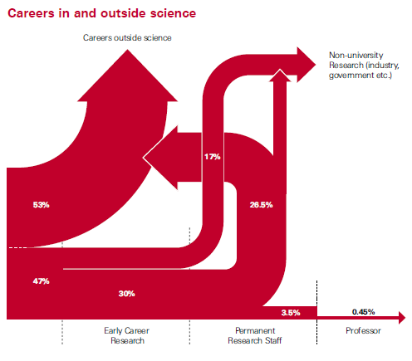

Slide 9
Exercise
Share in the chat – why do you want to do a PhD?

Slide 10
Some things to bear in mind…
Don't (with some jest, and some seriousness)
look out for opportunities for internships offered by departments or volunteering ops that get them in to contact with the day-to-day of research jobs.
Use Undergrad And PGT to find out what they're passionate about. And in terms of PGT, who you might ultimately want to work with.
Find out what's going on in the field - big area studies societies are good for this - because the thing that excites you might be so ten years ago. Also sub disciplines might exist that you were previously unaware of.
Talk to tutors, talk to current PhDs, but also remember to take with a pinch of salt because the landscape is changing so fast so what worked for them may not work for you

Slide 11
How to apply for and fund a PhD:
https://www.qmul.ac.uk/postgraduate/research/applying-for-a-phd/
Identify a research match
Review entry requirements and funding
Prepare a research proposal (or not)
Gather your documents & apply online
What happens next?!

Slide 12
Exercise!
You have 5 minutes to identify (use google), 2 academics who might supervise research in your area!

Slide 13
Key dates
Most funding deadlines will be January 31st 2022
NB: Law deadline is usually December
Contact supervisors over the coming term.
‘project’ information is usually available 1st week in November

Slide 14
Any questions?
Email me:
z.parker@qmul.ac.uk

